Slide 1




Banking, Financial Services And Insurance (BFSI)
BANK MARKETING
PORTUGAL

Slide 2


THE CREW
SURAMPUDI VNSS
SIVA KRISHNA
VIVEK
GUTTI
ABHISHEK VINJARAPU
JOSYULA VENKATA DINKAR CHAITANYA
PRASHANTH
PENDELA
ANIMESH TIWARI
Mentor

Slide 3

GIST OF DOMAIN
Project Background:-
Nowadays, marketing expenditures in the banking industry are massive, meaning that it is essential for banks to optimize marketing strategies and improve effectiveness. Understanding customers’ need leads to more effective marketing plans, smarter product designs and greater customer satisfaction.
Main Objectives:
Predict customers' responses to future marketing campaigns & increase the effectiveness of the bank's telemarketing campaign. This project will enable the bank to develop a more granular understanding of its customer base, predict customers' response to its telemarketing campaign and establish a target customer profile for future marketing plans.
Problem Statement..!
The data is related with direct marketing campaigns of a Portuguese banking institution. The marketing campaigns were based on phone calls. Often, more than one contact to the same client was required, in order to access if the product (bank term deposit) would be (or not) subscribed.

Slide 4
ROAD MAP
EXPLORATORY
DATA ANALYSIS
STATISTICAL ANALYSIS
BASELINE MODEL
1
2
3
2
2
DATA
PERFORMANCE TUNING
ENSEMBLES
5
4
5
4
PREDICTIONS
EVALUATION
6
7
6
7
BUSINESS SOLUTION

Slide 5

DATA DESCRIPTION
Numerical | Description
Age | Age of client
Balance | Average yearly balance
Duration | Last contact duration
Pdays | Number of days that passed by after the client was last contacted from a previous campaign
Previous | Number of contacts performed before this campaign and for this client
Day | Last contact day of the month
Campaign | Number of contacts performed during this campaign and for this client
Categorical | Description
Job | Type of job
Martial | Marital status
Education | Level of education
Default | Has credit in default ?
Housing | Has housing loan ?
Loan | Has personal loan ?
Contact | Contact communication type
Month | Last contact month of year
Deposit | Has the client subscribed a term deposit ?
Poutcome | Outcome of the previous marketing campaign

Slide 6





SWOT ANALYSIS
STRENGTHS
WEAKNESS
Can understand the demographics of the customers.
No missing values.
Imbalanced data.
Having outliers in the data set.
Having many unknown in subcategories of the data set.
Strengths
Weakness
THREATS
Threats
OPPORTUNITIES
When a subscriber is classified as a non-subscriber it can lead to a bad customer experience (basically wrong conclusions) and it can be a loss to business.
Opportunities
Use the data to create more new features and predict whether the customer will do term deposit.
Study the hidden patterns in demographics and make relevant recommendation to the business

Slide 7
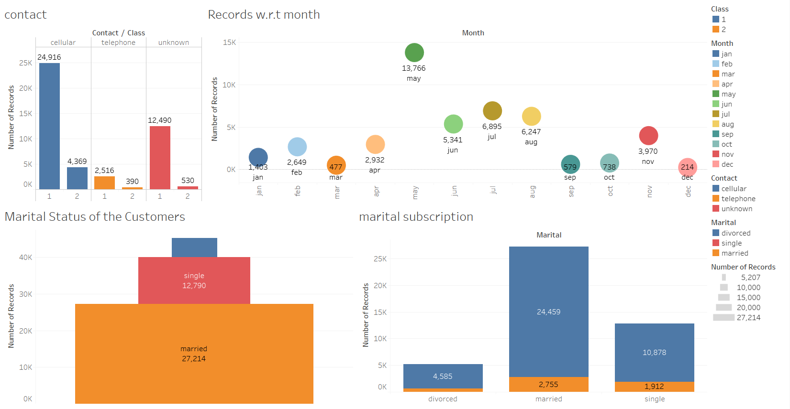
EXPLORATORY DATA ANALYSIS

Slide 8
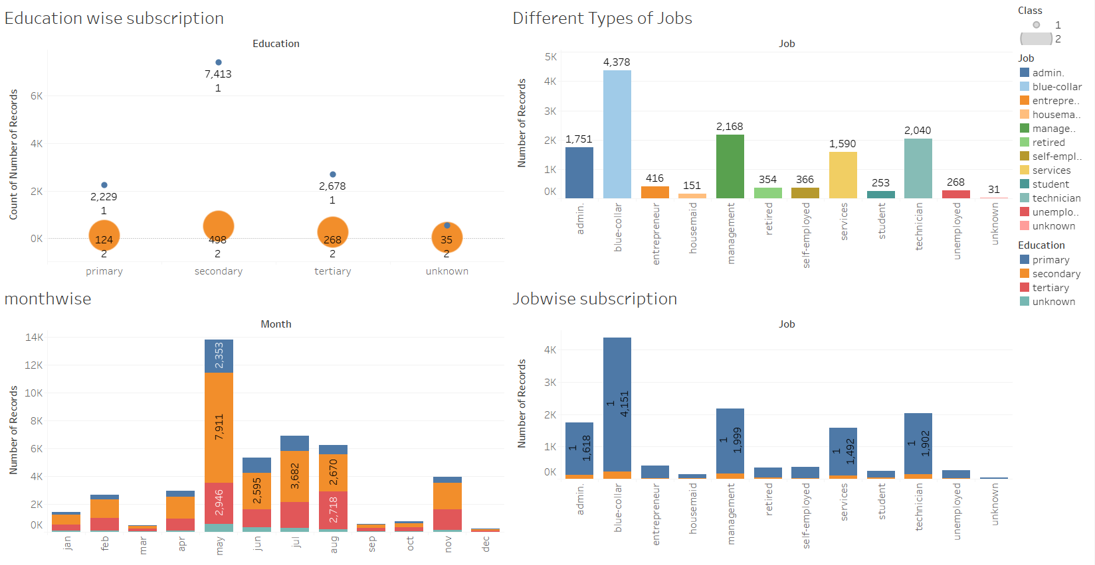
EXPLORATORY DATA ANALYSIS

Slide 9
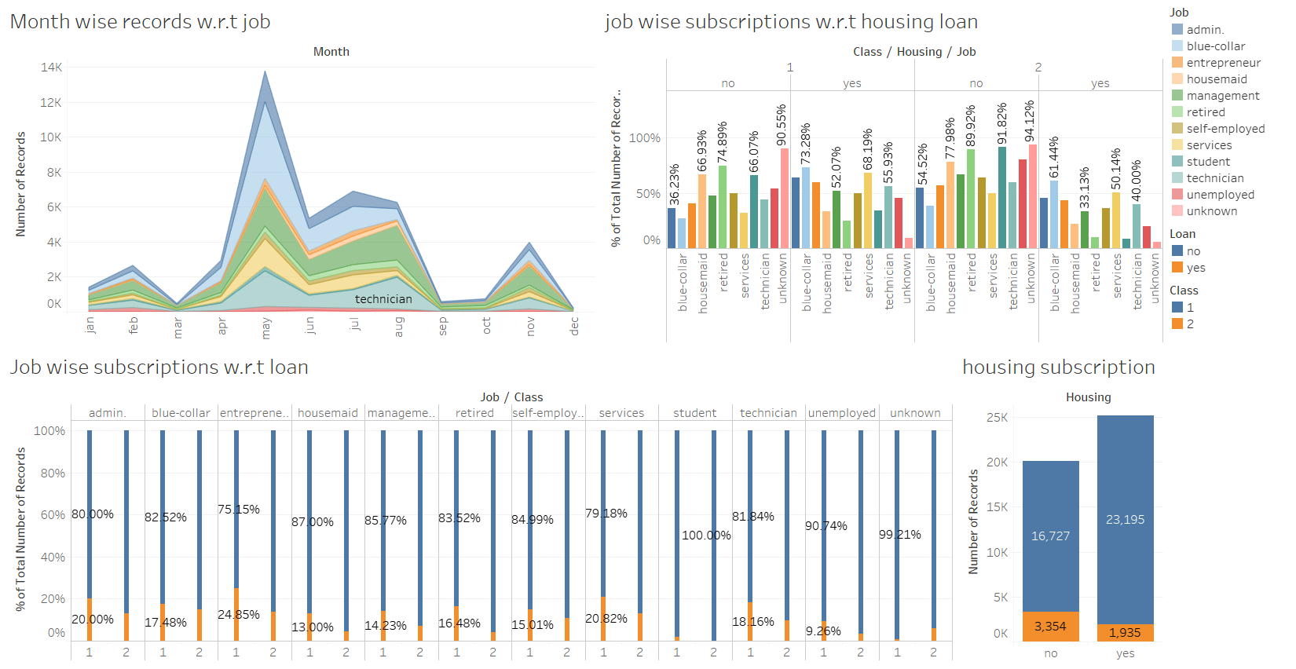
EXPLORATORY DATA ANALYSIS

Slide 10
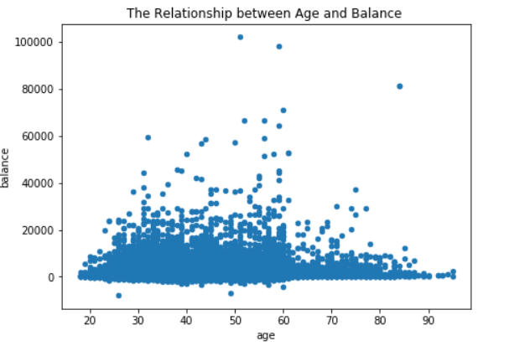
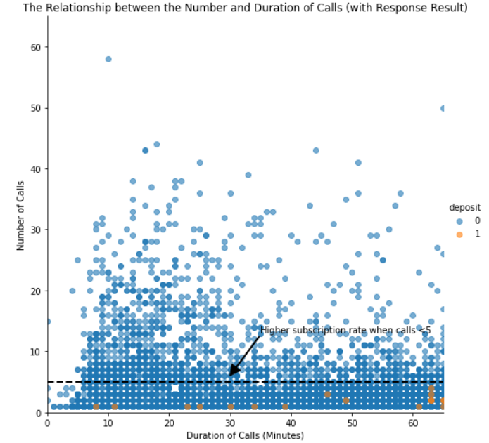
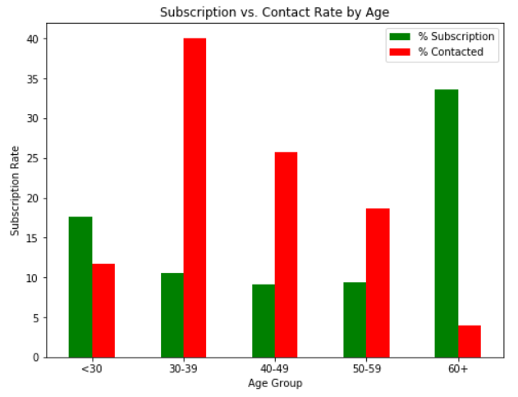
EXPLORATORY DATA ANALYSIS

Slide 11
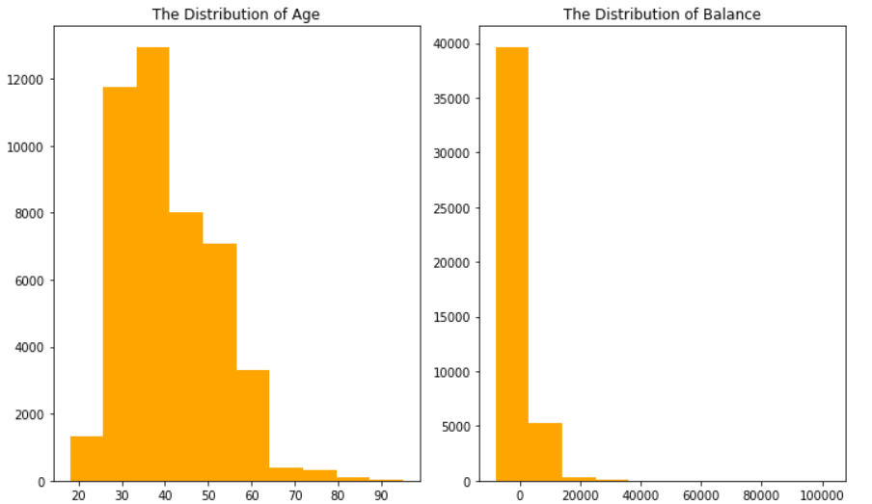
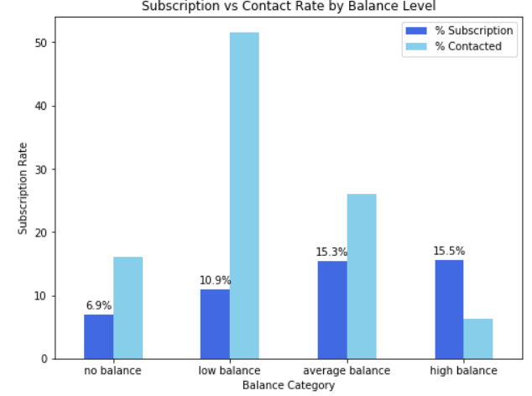
EXPLORATORY DATA ANALYSIS

Slide 12
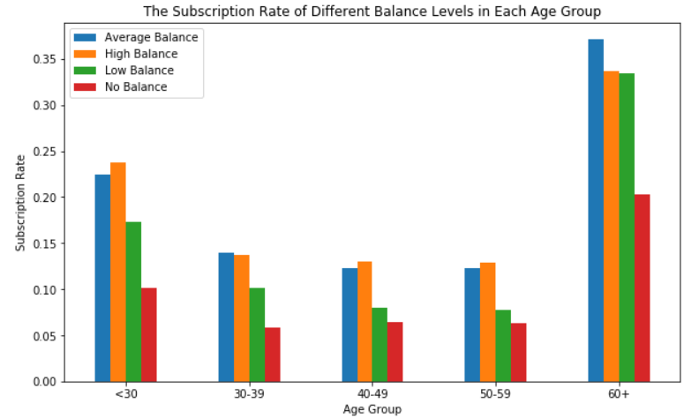
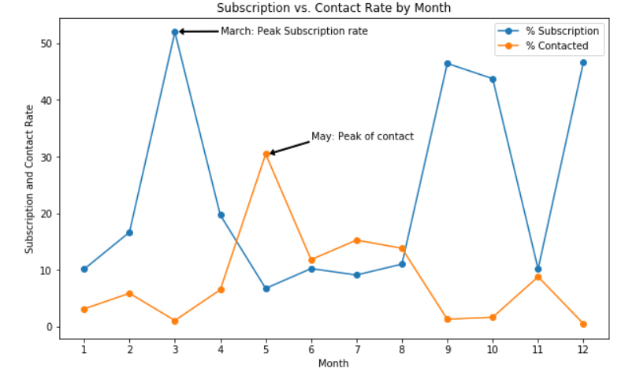
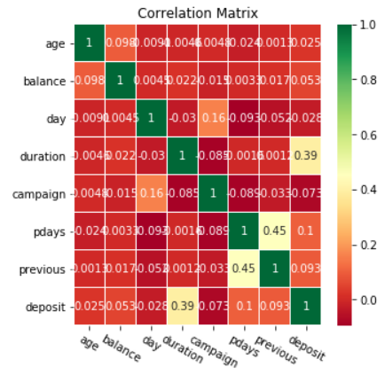
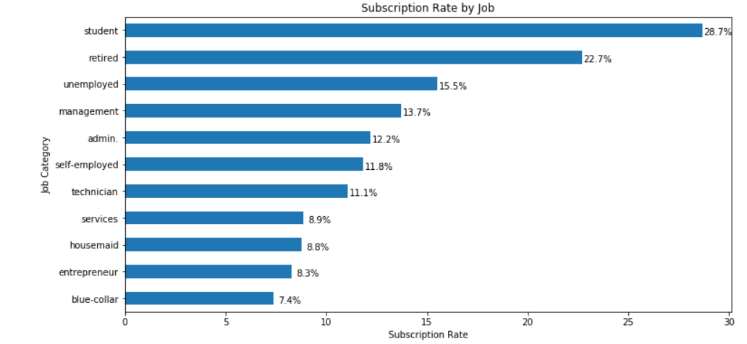
EXPLORATORY DATA ANALYSIS

Slide 13
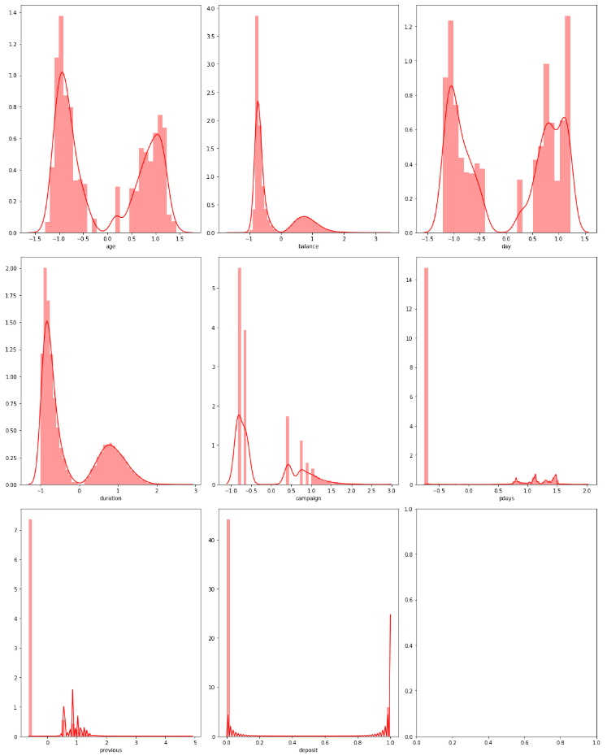
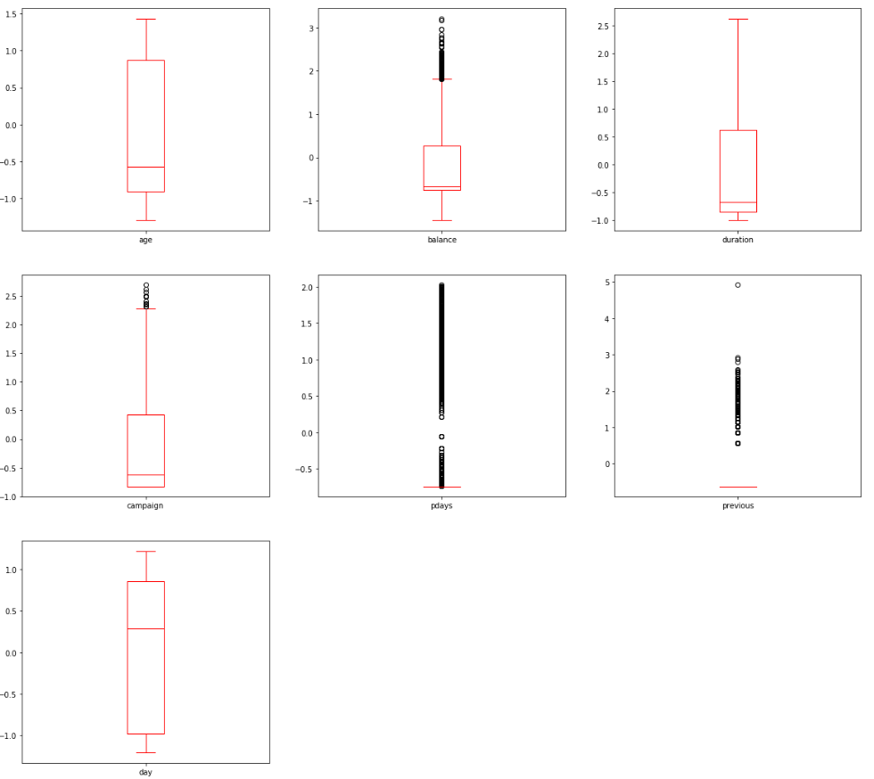
EXPLORATORY DATA ANALYSIS
NORMALITY & OUTLIERS OF THE FEATURES AFTER OUTLIER’S TREATMENT

Slide 14

STATISTICAL DATA ANALYSIS
Variable | P value | Decision
Age | 0.009 | Reject H0
Balance | 0.000 | Reject H0
Day | 0.691 | Fail to reject H0
Duration | 0.000 | Reject H0
Campaign | 0.000 | Reject H0
Pdays | 0.000 | Reject H0
Previous | 0.066 | Fail to reject H0
job_blue-collar | 0.000 | Reject H0
job_entrepreneur | 0.000 | Reject H0
job _housemaid | 0.000 | Reject H0
job_management | 0.000 | Reject H0
job_retired | 0.367 | Fail to reject H0
job_self-employed | 0.000 | Reject H0
Variable | P value | Decision
job_services | 0.001 | Reject H0
job_student | 0.011 | Reject H0
job_technician | 0.000 | Reject H0
job_unemployed | 0.001 | Reject H0
Marital_married | 0.000 | Reject H0
Marital_single | 0.259 | Fail to reject H0
Education secondary | 0.716 | Fail to reject H0
EducationTertiary | 0.002 | Reject H0
Default_yes | 0.197 | Fail to reject H0
Housing_yes | 0.000 | Reject H0
Loan_yes | 0.000 | Reject H0
Contact_ telephone | 0.124 | Fail to reject H0
Contact_ unknown | 0.000 | Reject H0
Variable | P value | Decision
Month_aug | 0.000 | Reject H0
Month_dec | 0.006 | Reject H0
Month_feb | 0.002 | Reject H0
Month_jan | 0.000 | Reject H0
Month_jul | 0.000 | Reject H0
Month_jun | 0.001 | Reject H0
Month_mar | 0.000 | Reject H0
Month_may | 0.000 | Reject H0
Month_nov | 0.000 | Reject H0
Month_oct | 0.000 | Reject H0
Month_sept | 0.000 | Reject H0
Poutcome_other | 0.583 | Fail to reject H0
Poutcome Success | 0.000 | Reject H0
Poutcome Unknown | 0.000 | Reject H0

Slide 15
TEST FOR MULTICOLLINEARITY
Variable | VIF | Decision
Age | 1.191235 | Vif<4
Balance | 1.254509 | Vif<4
Duration | 1.095079 | Vif<4
Campaign | 1.172748 | Vif<4
Pdays | 9.854012 | Vif>4
job_blue-collar | 2.400730 | Vif<4
job_entrepreneur | 1.253233 | Vif<4
job _housemaid | 1.169404 | Vif<4
job_management | 3.208361 | Vif<4
job_self-employed | 1.266121 | Vif<4
job_services | 1.568416 | Vif<4
job_student | 1.175649 | Vif<4
job_technician | 2.050722 | Vif<4
Variable | VIF | Decision
job_unemployed | 1.183071 | Vif<4
Marital_married | 2.791225 | Vif<4
EducationTertiary | 2.680599 | Vif<4
Housing_yes | 3.126247 | Vif<4
Loan_yes | 1.255778 | Vif<4
Contact_ unknown | 3.292653 | Vif<4
Month_aug | 3.120586 | Vif<4
Month_dec | 1.069575 | Vif<4
Month_feb | 1.697968 | Vif<4
Month_jan | 1.369884 | Vif<4
Month_jul | 3.205897 | Vif<4
Month_jun | 3.354037 | Vif<4
Variable | VIF | Decision
Month_mar | 1.141809 | Vif<4
Month_may | 6.000556 | Vif>4
Month_nov | 2.074751 | Vif<4
Month_oct | 1.215499 | Vif<4
Month_sept | 1.176379 | Vif<4
Poutcome Success | 1.227866 | Vif<4
Poutcome Unknown | 36.643430 | Vif>4

Slide 16
EVALUATION METRICS
Proportion of correctly identified instances
F1
SCORE
Proportion of predicted positives
RECALL
ACCURACY
PRECISION
Harmonic mean of Precision and Recall
Proportion of Actual positives predicted correctly

Slide 17
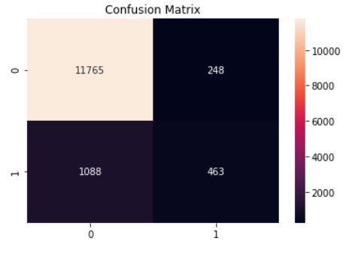
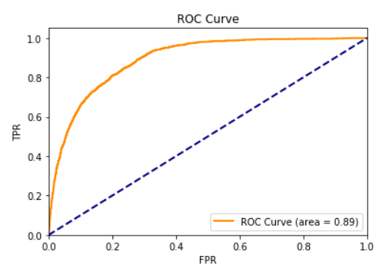
BASELINE MODEL
Logistic Regression Metrics (Imbalanced Data)
Accuracy | 0.9015039811265113
Precision | 0.6511954992967651
Recall | 0.2985170857511283
F1-Score | 0.4093722369584439

Slide 18
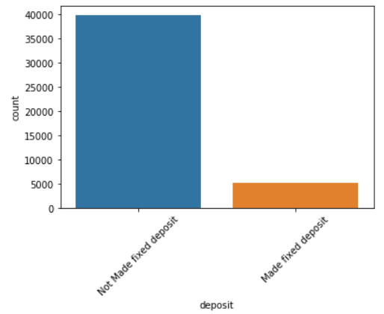
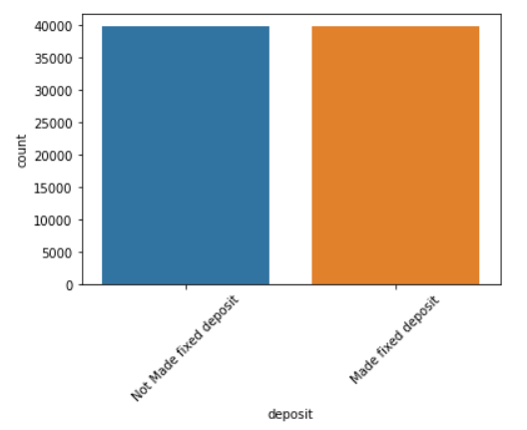
OVERSAMPLING DATA WITH SMOTE
IMBALANCE IN THE TARGET VARIABLE
OVERSAMPLING THE TARGET VARIABLE BY USING SMOTE

Slide 19
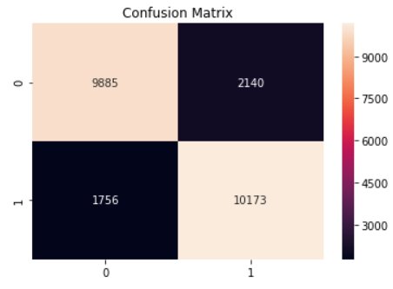
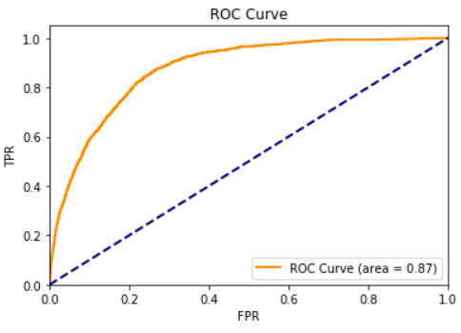
BASELINE MODEL
Logistic Regression Metrics (Balanced Data)
Accuracy | 0.8373549302830425
Precision | 0.8261999512710144
Recall | 0.8527957079386369
F1-Score | 0.8392871875257817

Slide 20
ALGORITHMS COMPARISION (BIAS & VARIANCE ERROR) THROUGH K-FOLD CROSS VALIDATED DATA
Naive Bayes
Decision Tree
Bagging Classifier
Gradient Boost
Bias error = 0.836783
Variance Error = 0.000002
Bias error = 0.880156
Variance Error = 0.000004
Bias error = 0.920787
Variance Error = 0.000003
Bias error = 0.884917
Variance Error = 0.000001
Logistic Regression
KNN
Random Forest
Ada Boost
Bias error = 0.744287
Variance Error = 0.000049
Bias error = 0.875544
Variance Error = 0.000013
Bias error = 0.910145
Variance Error = 0.000002
Bias error = 0.890308
Variance Error = 0.000016

Slide 21
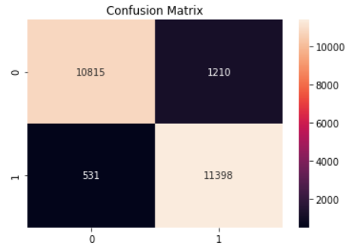
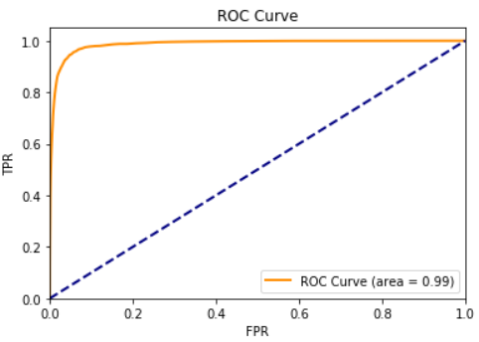
BEST MODEL (BAGGING CLASSIFIER)
RF Classifier Metrics (Balanced Data)
Accuracy | 0.9125407030141104
Precision | 0.9050914483440435
Recall | 0.9209489479419901
F1-Score | 0.9129513441642083

Slide 22

GUESSTIMATE
Out of 100 customers, how many opt for the subscription ?
Let 10$ be the amount spent by bank to contact a customer
Let 1000$ be the average term deposit
With base model :
The amount spent for contacting 100 customers is 1000$
Out of 100 customers only three subscribed. So, the amount earned by the bank is 3000$
The total amount gained is 2000$
With final model :
The amount spent for contacting 100 customers is 1000$
Out of 100 customers 47 subscribed. So, the amount earned by the bank is 47000$
The total amount gained is 46000$
Therefore, there is 95% gain if the bank incorporate our model.

Slide 23
BUSINESS SOLUTION
The main objective of this project is to increase the effectiveness of the bank's telemarketing campaign, which was successfully met through data analysis, visualization and analytical model building. A target customer profile was established while classification models were built to predict customers' response to the term deposit campaign.
According to previous analysis, a target customer profile can be established. The most responsive customers possess these features:
Feature 1: age < 30 or age > 60
Feature 2: students or retired people
Feature 3: a balance of more than 5000 euros
Feature 4: should focus on people who are not having personal or housing loan
By applying RF classifier algorithm the bank will be able to predict a customer's response to its telemarketing campaign before calling this customer. In this way, the bank can allocate more marketing efforts to the clients who are classified as highly likely to accept term deposits, and call less to those who are unlikely to make term deposits. With the aid of RF classifier model, the bank can enter a virtuous cycle of effective marketing, more investments and happier customers.
Recommendations :
More appropriate timing
Smarter marketing design
Better services provision

Slide 24





LET’S CLARIFY
THANK YOU

